Slide 1
Game Proposal 1 The Basics
Camilla Lucero | Cameron Loghry | Alex Snyder
GDD 1101-001

Slide 2
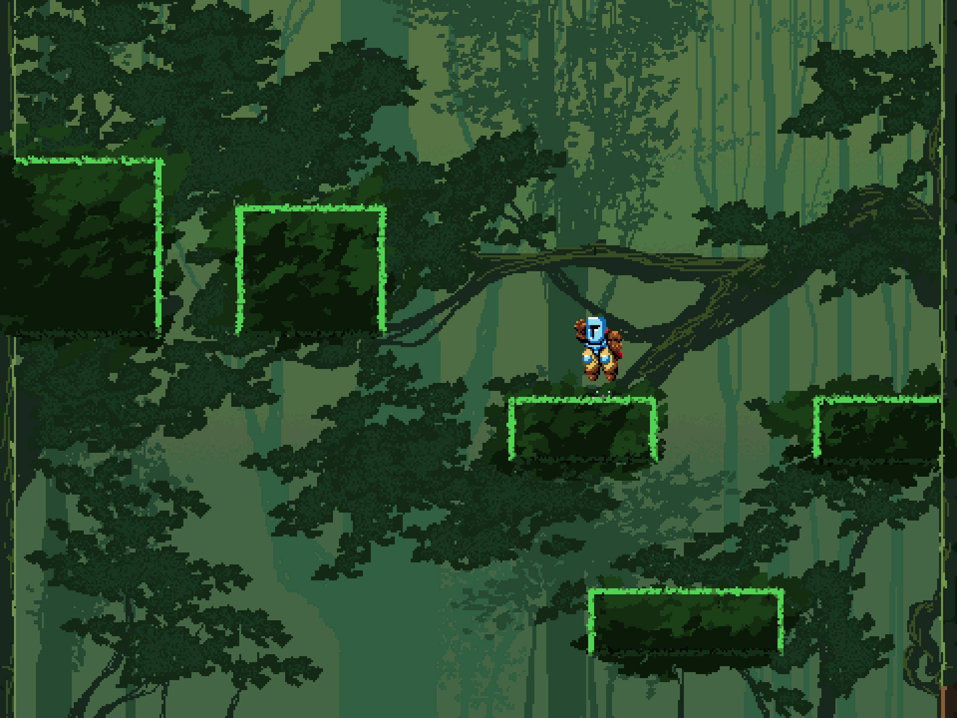
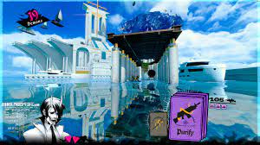
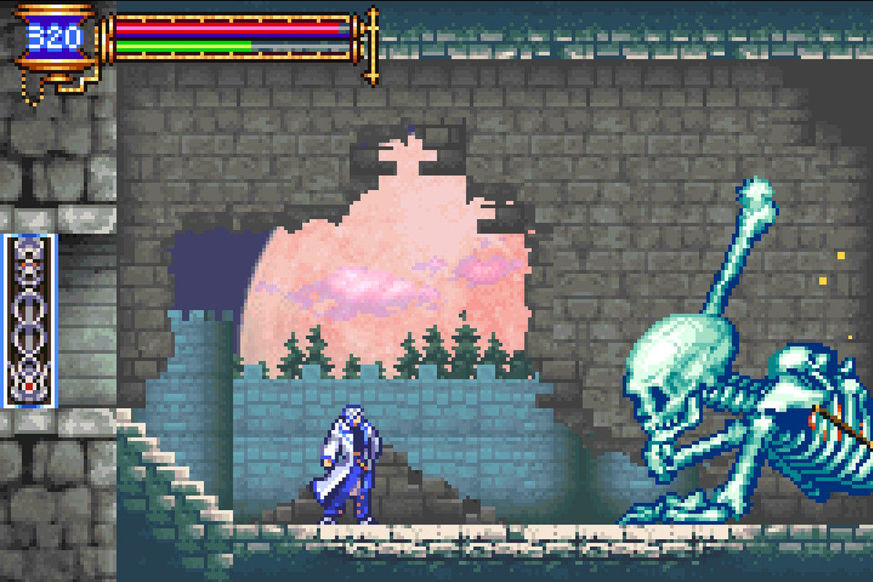
Castle Jump
Type of Game: Side-scroller, rouge-like, platformer.
Jobs:
Diplomat – Camilla
HR – Cameron
Boss - Alex
Jump king - https://nexile.se/jump-king/
Castlevania - https://www.polygon.com/22692213/castlevania-advance-collection-aria-of-sorrow-symphony-night-release-circle-moon-Konami
Neon White - https://store.steampowered.com/app/1533420/Neon_White/

Slide 3
Week 1 Goals
Player movement
Movement from left to right
Jumping and Gravity
Enemy movement
Set distance movement
Camera Setup
Camera follows the player

Slide 4
Why are we doing this and Why does it matter you?
We plan to make our game a challenging and interesting addition to side-scroller games by tying in aspects of rouge-like and platformer genres.
The three of us picked games, such as Neon White, Castlevania, Jump King, and other popular games, and discussed their most popular, most fun, and most interesting aspects so that we could create something new.

Slide 5
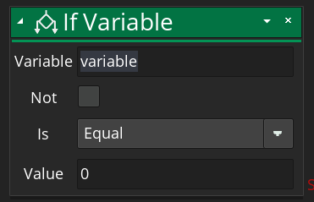
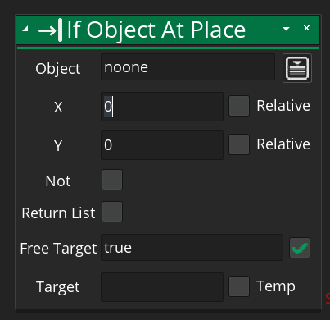
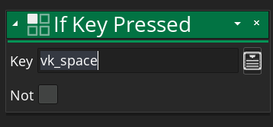
If Key Pressed:
Denoted as key_pressed() in GML code.
Checks if a key is pressed.
“If _____, Do ______”
This will be the main way we receive player input for movement.
If Statement:
Allows for choices within code
“If ____ then ____,
else If ____ then ___...”
We plan to use this statement to assist our movement choices, both for our PC and our Enemy objects.
If Object At Place:
Denoted as placemeeting() within GML code.
Determines if a collision in occurring between two objects or at a certain point.
We plan to use this when setting up our player collision and Enemy collision.

